Slide 1
Stubs & Mocks
C Unit Testing

Slide 2
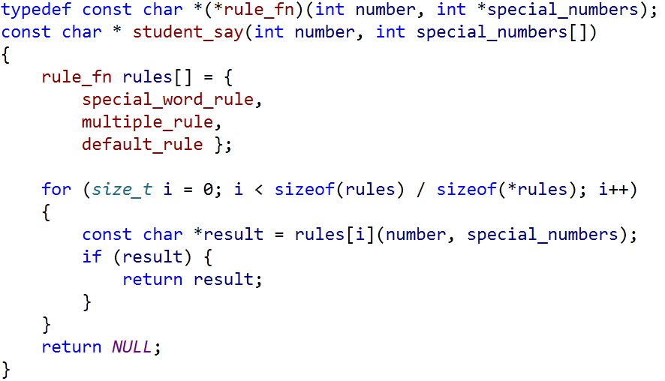
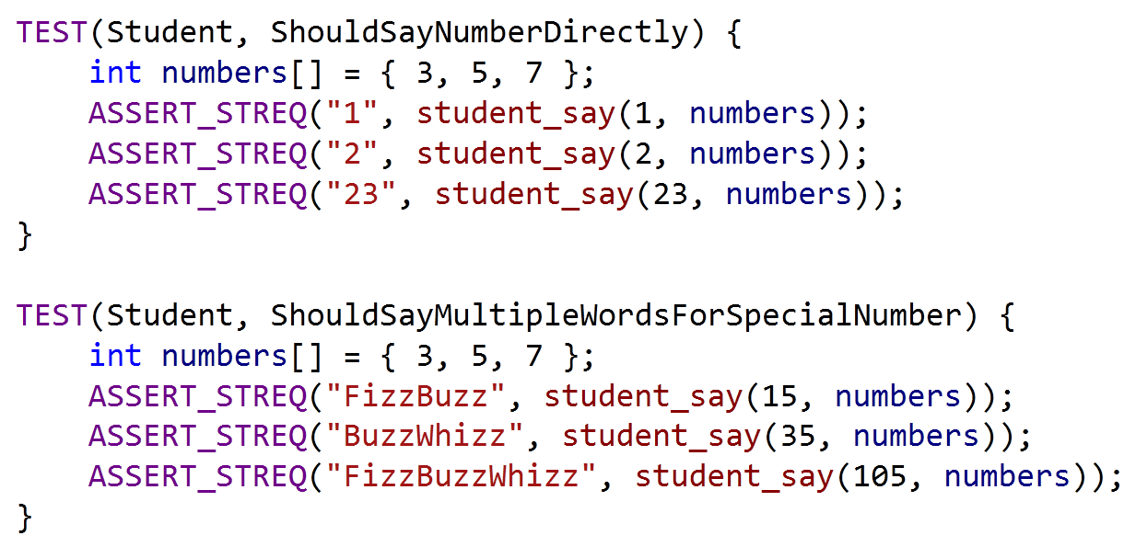

After Refactoring
Game Rules
How To Test student_say()

Slide 3

Open Closed Principle

Slide 4
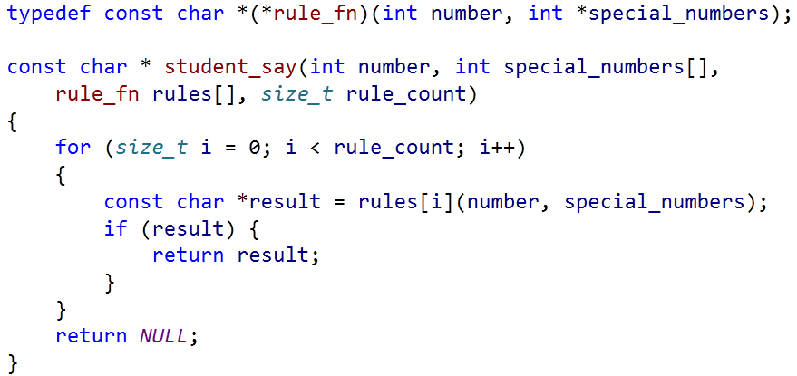
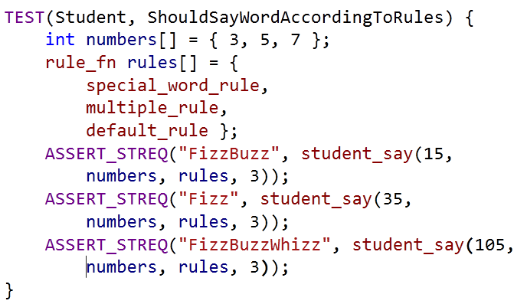
Injecting Rules
student_say no longer creates rules
Caller(Test) creates and injects rules into student_say
Injects

Slide 5
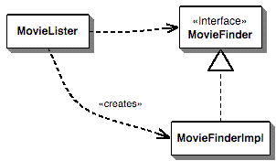
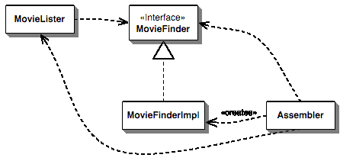
Dependency Injection
MovieLister uses MovieFinder
MovieLister creates MovieFinderImpl
MovieLister uses MovieFinder
Assembler creates MovieFinderImpl
Assembler inject MovieFinderImpl into MovieLister

Slide 6
Advantages
Dependency Injection decreases coupling between a class and its dependency.
Dependency injection allows a client to remove all knowledge of a concrete implementation that it needs to use.
Dependency injection can be used to externalize a system's configuration details into configuration files.
Dependency injection allows concurrent or independent development.
Easier to unit test in isolation using stubs or mock objects that simulate the dependent objects.

Slide 7
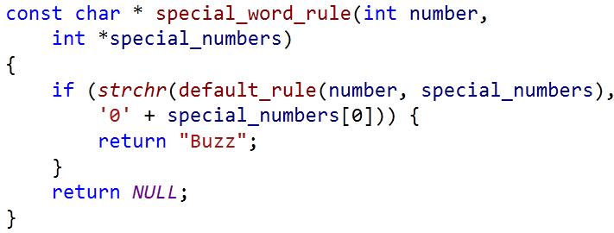
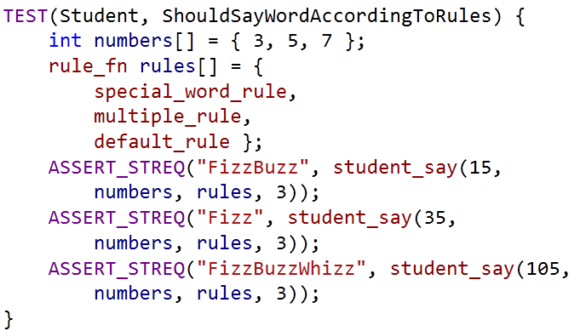
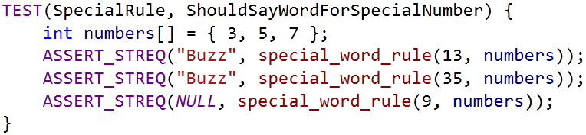
Rule Updated
学生报数时，如果所报数字包含了第一个特殊数，那么也不能说该数字，而是要说相应的单词，比如本例中第一个特殊数是3，那么要报13的同学应该说
Buzz
Fizz
System Under Test(SUT)

Slide 8
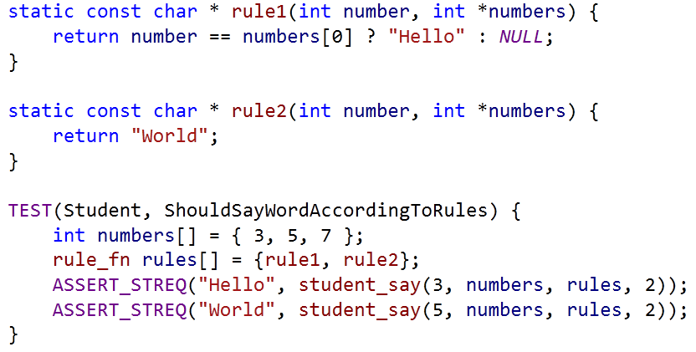
Using Fakes
Calls first rule with input number and special numbers
Returns result if it is not null
Otherwise try the next rule
Rule1 returns Hello if input equals first special number
Rule2 always returns World

Slide 9
Mocking
With Google Mock

Slide 10
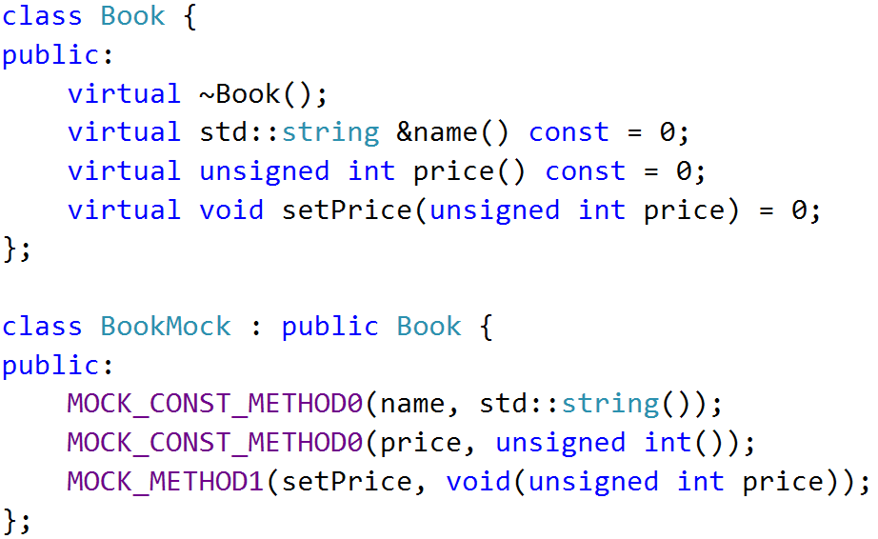

MOCK Object
A mock object implements the same interface as a real object (so it can be used as one), but lets you specify at run time how it will be used and what it should do

Slide 11
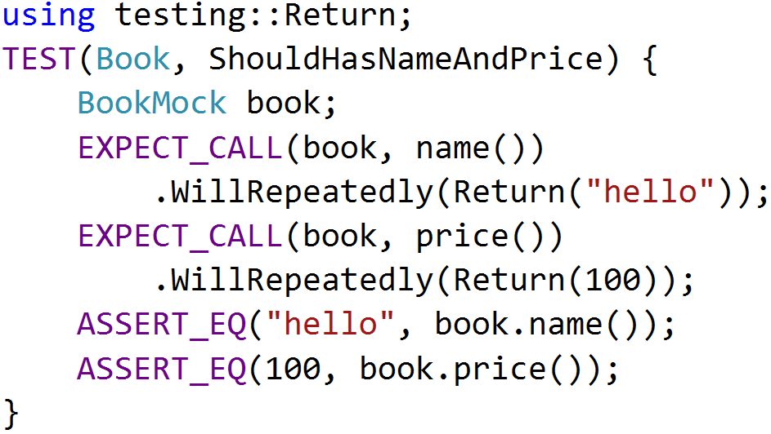
EXPECTATIONS
Use the EXPECT_CALL() macro to set an expectation on a mock method

Slide 12
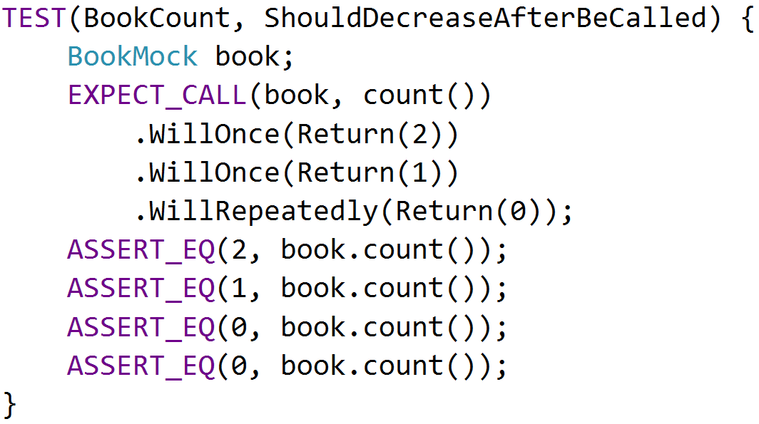
ACTIONS
The return value of mock functions can be specified by Will and Return Statement

Slide 13
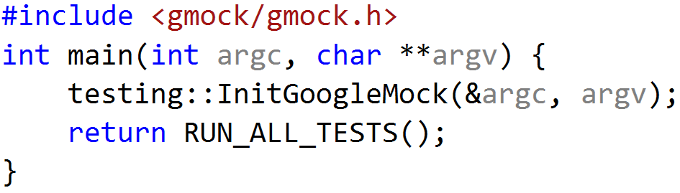
USING GMOCK
include <gmock/gmock.h>
write your mocks and tests
initialize gmock by InitGoogleMock()
call RUN_ALL_TESTS() in main() function
compile and run
InitGoogleMock() will automatically initialize Google Test

Slide 14
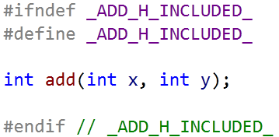
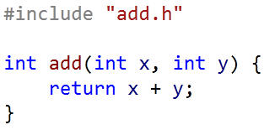
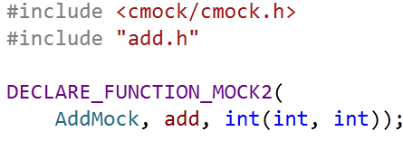
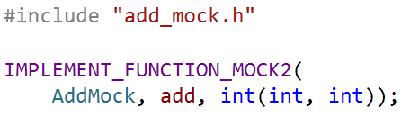
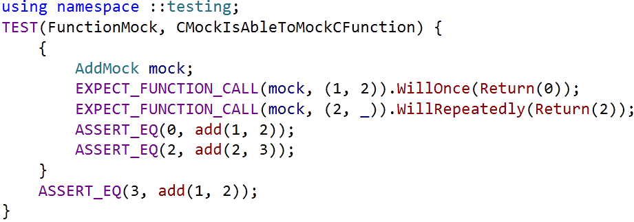
USING CMOCK – Google Mock Extension
add.h
add.c
add_mock.h
add_mock.cpp
add_test.cpp

Slide 15

EXERCISE
完成student_say()的测试:
通过Mock来控制规则, 根据输入参数返回预设的单词
按照预设的规则对student_say()进行验证

Slide 16
WEATHER NOTIFIER
小明是一名暖男程序员, 为了体现对女朋友的关心, 小明决定写一个程序自动在天气变化时向女朋友手机上发送一条提醒信息例如当天如果下雨, 则自动向她的手机上发送一条"今天下雨,记得带伞哦“
小明经过一番努力, 发现某网站提供如下两个API, 能够帮助他实现梦想:
GET http://api.com/weather-api?location={CityName}取指定城市的天气情况, 会返回sunny, raining等状态
POST http://api.com/sms-gateway?number={PhoneNumber} &content={Message}指定手机号发送短信

Slide 17

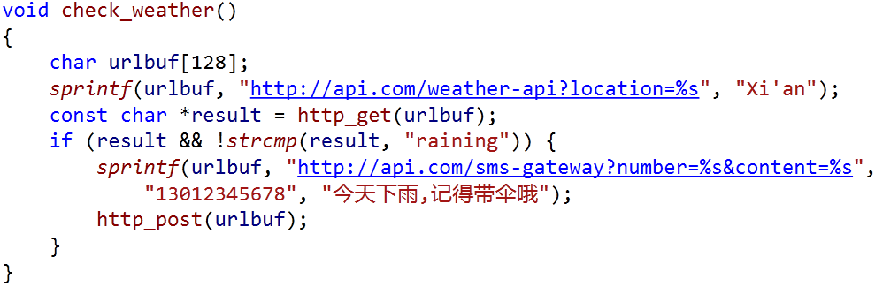
WEATHER NOTIFIER
http_client.h
weather_notifier.c
获取天气的API需要网络连接, 并且最近持续是晴天
发送短信的API同样需要网络连接, 并且还会收费

Slide 18
Stubs Vs Mocks
Behavior Based Verification

Slide 19
Test Doubles
Dummy objects are passed around but never actually used. Usually they are just used to fill parameter lists
Fake objects actually have working implementations, but usually take some shortcut which makes them not suitable for production
Stubs provide canned answers to calls made during the test, usually not responding at all to anything outside what's programmed in for the test
Mocks are objects pre-programmed with expectations which form a specification of the calls they are expected to receive

Slide 20
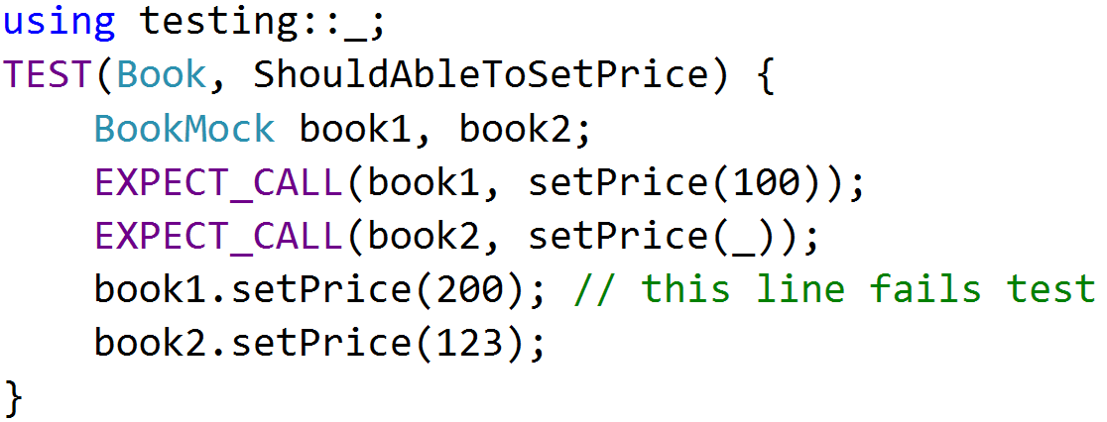
MATCHERS
When a mock function takes arguments, we can specify the expected arguments value
testing::_ will match any input arguments

Slide 21
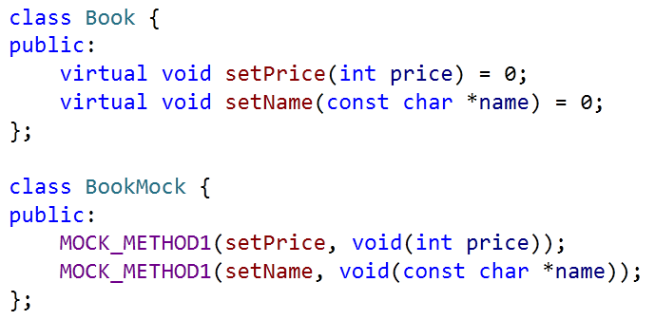
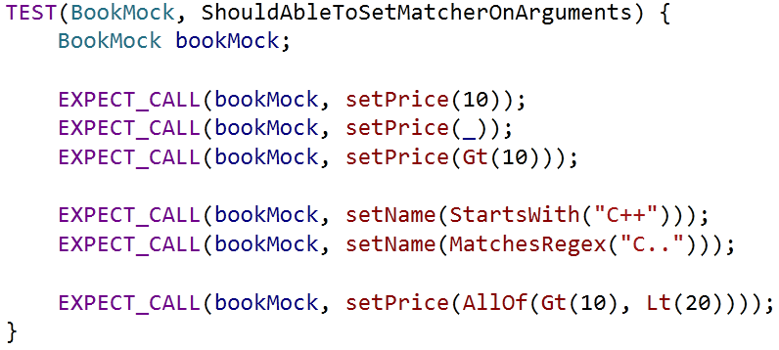
Advanced MatChers

Slide 22
Cardinalities
Use the Times() to specify the cardinality as it tells how many times the call should occur

Slide 23
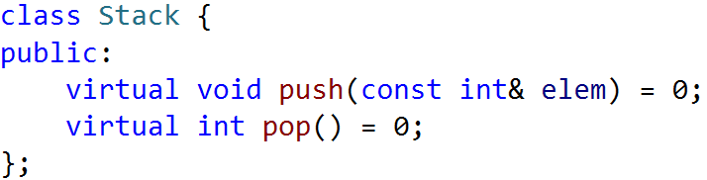
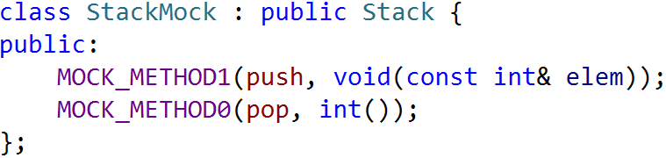
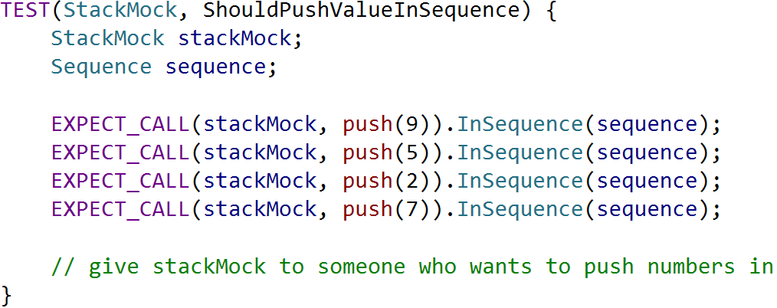
Expectation Order

Slide 24
EXERCISE
帮助小明完成测试:
进入ut-02-weather-notifier目录
校验传入http_get()的参数, 并返回预设的天气信息
当雨天时调用http_post()并检查传入的参数
晴天时不调用http_post()发送短信

Slide 25
WHY MOCK
You want to "mock out" your dependencies.
Your tests are slow as they depend on too many libraries or use expensive resources (e.g. a database).
Your tests are brittle as some resources they use are unreliable (e.g. the network, current time).
You want to test how your code handles a failure which is not easy to trigger.
Dependent Interface Does not yet exist or may change behavior.

Slide 26
CMOCK LIMITIONS
C Mock uses internally some tricks specific to GNU/Linux platform and a test building requires a few additional steps.
Firstly, all functions you want to mock must be in dynamic libraries. If it includes your project-specific functions you must put them to dynamic library.
Secondly, you must pass following options to linker when building test executable:
-rdynamic - add all symbols to dynamic symbol table
-Wl,--no-as-needed - link with library event though during static linking there are no dependencies to it
-ldl - dynamic linking loader library

Slide 27
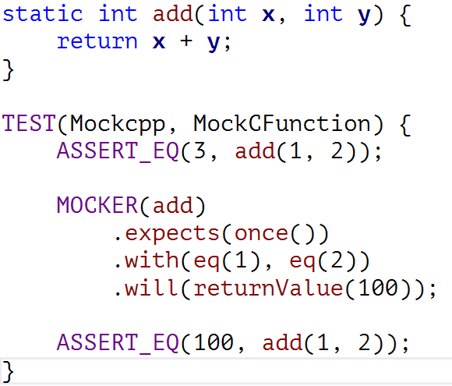
Mocking With Mockcpp
Mockcpp Mocker

Slide 28
Reference
https://code.google.com/p/googlemock/wiki/ForDummies
https://code.google.com/p/googlemock/wiki/CheatSheet
https://code.google.com/p/googlemock/wiki/CookBook
https://code.google.com/p/googlemock/wiki/FrequentlyAskedQuestions
https://github.com/coney/C-Mock
https://code.google.com/p/mockcpp/

Slide 29
Q & A

Slide 30
THANK YOU
For questions or suggestions:
Wu Kun
kunwu@thoughtworks.com

